Slide 1

AgriFlow Intelligence
End-to-End Automated Agricultural ETL Pipeline
PRESENTED BY KABELO MODIMOENG | DATA ENGINEER

Slide 2

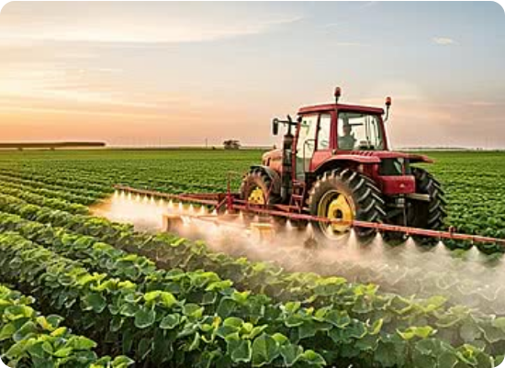
The Business Problem
■
Disconnected Systems: Internal harvest logs (CSV formats) are completely isolated from external market pricing feeds (JSON APIs).
■
Manual Bottlenecks: Calculating daily operational profit margins requires tedious manual data matching and complex financial transformations.
■
Lack of Analytics: Data isn't structured or stored appropriately for business intelligence (BI) integration or historical trend analysis.

Slide 3








The Engineering Solution
Automated Ingestion
In-Memory Processing
Idempotent Warehouse
Robust Bash scripts immediately validate file integrity and safely move raw data into a structured staging environment.
Python and Pandas scripts extract the staged files to handle complex data joins and apply critical financial calculations entirely in-memory.
Clean data is loaded into a PostgreSQL Star Schema built specifically for OLAP queries, utilizing logic that prevents duplicate data.

Slide 4
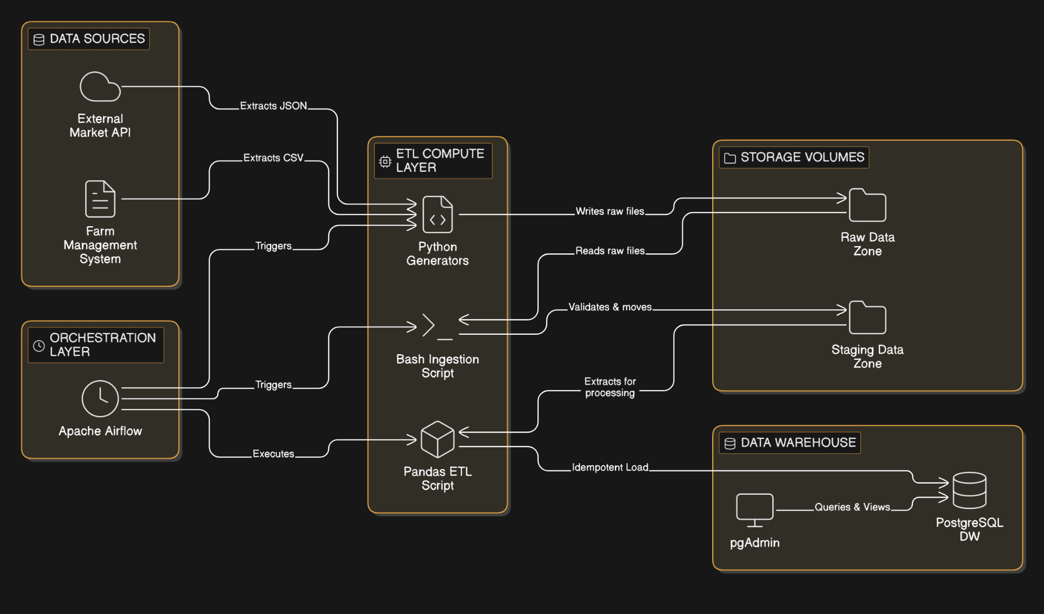
System Architecture
The system utilizes a modern, modular Docker-compose architecture separating orchestration, computation, and storage.
Logical source systems simulate raw data generation, flowing into local Data Lake volumes. Apache Airflow acts as the master control plane.
Airflow schedules and triggers Python ETL scripts that extract, transform, and load structured, clean data directly into the PostgreSQL Star Schema.

Slide 5

Data Modeling (The Star Schema)
The Fact Table
The Dimension Tables
The central fact_harvest_yield table contains the quantitative business metrics. It stores exact calculations for Yield KG, total Spoilage, gross Revenue, and net Profit ZAR. It uses surrogate keys to map back to descriptive dimensions.
Provides critical descriptive context via dim_crop, dim_farm, and dim_date hierarchies. Python logic dynamically resolves incoming business keys to their correct database surrogate keys strictly during the load phase.

Slide 6
Key Technical Challenges Overcome
Idempotent Operations Prevented duplicate records on DAG re-runs by implementing a robust DELETE-before-INSERT strategy in Pandas, targeting the specific `date_id`.
Cross-Platform Execution Automated `sed` text cleaning was injected directly into the Airflow BashOperator to prevent hidden Windows CRLF line endings from breaking Linux scripts.
Race Condition Mitigation Engineered strict Docker-compose dependencies to perfectly synchronize container boot sequences, preventing the UI from crashing before the DB initialized.

Slide 7
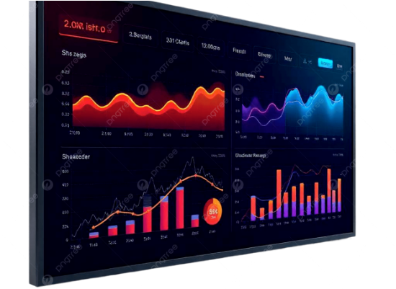
The Final Output
■
Unified Intelligence: Data is fully unified, cleaned, and enriched with complex financial logic.
■
Single Source of Truth: The PostgreSQL warehouse creates a reliable, centralized location for all agricultural profitability metrics.
■
BI Ready: The resulting Star Schema is 100% ready for direct connection to downstream analytics tools like Power BI or Tableau.

Slide 8

Thank You
Kabelo Modimoeng | Data Engineer

Slide 9


Image Sources
https://png.pngtree.com/thumb_back/fh260/background/20241130/pngtree-modern-agricultural-tractor-spraying-a-green-field-with-pesticides-under-clear-image_16678460.jpg
Source: pngtree.com
https://png.pngtree.com/png-clipart/20250207/original/pngtree-modern-data-visualization-screen-for-analytics-dashboard-png-image_20373725.png
Source: pngtree.com

